Slide 1
(A)zure

Slide 2
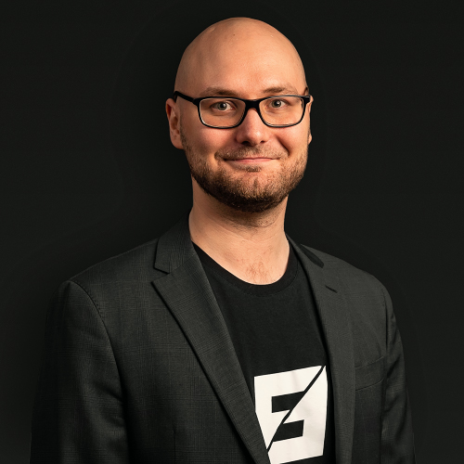


Trainer
Karl Ots
Chief Consulting Officer
karl.ots@zure.com
Cloud & cybersecurity expert
Professional experience with Azure since 2011
Patented inventor
Worked with 100+ Azure projects, with clients ranging from startups to Fortune 500 enterprises
linkedin.com/in/karlots

Slide 3
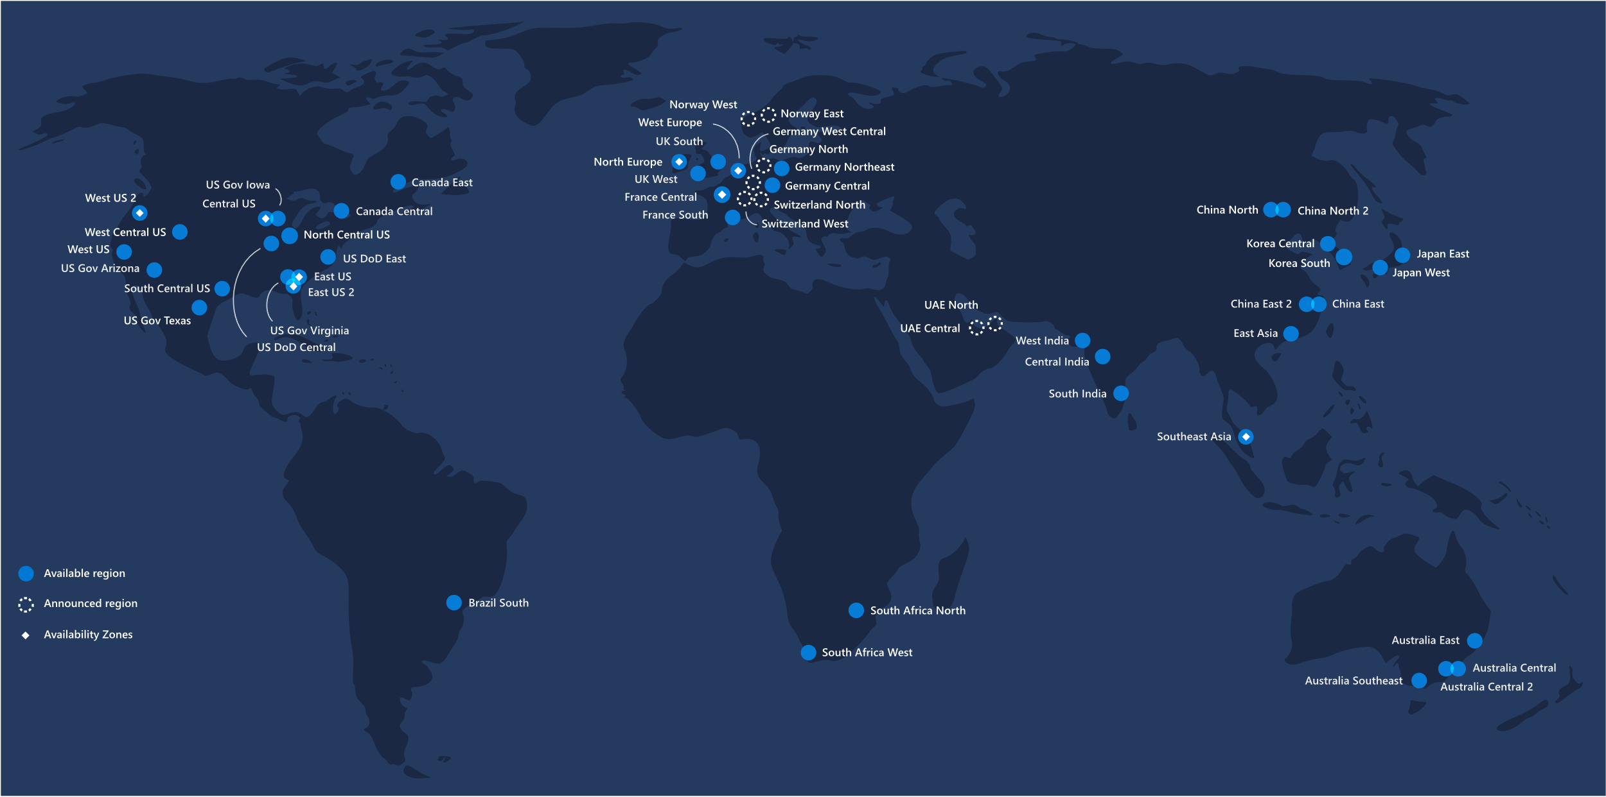
Notes:
Hyperscale (emphasis on scale)
Only a few companies have the business need and opportunity to operate computing at a scale where you are no longer an IT shop, but a global infrastructure supply chain. The servers and network hardware become commodities and the special sauce is in the planning, execution and optimization of the service –managing the illusion of infinite capacity.
Global operations
This takes knowing how to operate around the globe, something that Microsoft has great experience in. We have operated international datacenters and networks for over 20 years and continue to grow our footprint outside the US. This is another cog in the supply chain – standing up new infrastructure, offerings and business models – operating ourselves or through partners in locations like China and Germany
Automation
Watching screens and waiting for alerts or emails is not sufficient at our scale. We have had to become experts at automation - Some of our datacenter campuses are two miles (3km) long – software can react to a problem much faster than a human can

Slide 4
2 Mil kilometers intra-datacenter fiber
72+
Tb per second
Backbone
54 Azure regions
100+ datacenters
Millions of servers
Notes:
Hyperscale (emphasis on scale)
Only a few companies have the business need and opportunity to operate computing at a scale where you are no longer an IT shop, but a global infrastructure supply chain. The servers and network hardware become commodities and the special sauce is in the planning, execution and optimization of the service –managing the illusion of infinite capacity.
Global operations
This takes knowing how to operate around the globe, something that Microsoft has great experience in. We have operated international datacenters and networks for over 20 years and continue to grow our footprint outside the US. This is another cog in the supply chain – standing up new infrastructure, offerings and business models – operating ourselves or through partners in locations like China and Germany
Automation
Watching screens and waiting for alerts or emails is not sufficient at our scale. We have had to become experts at automation - Some of our datacenter campuses are two miles (3km) long – software can react to a problem much faster than a human can

Slide 5
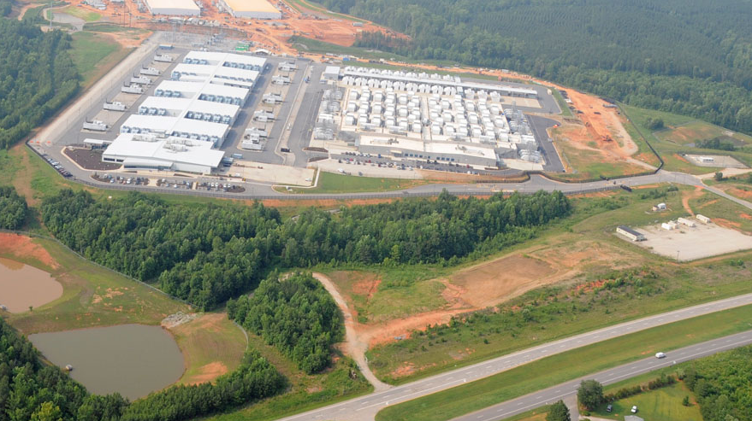

Slide 6
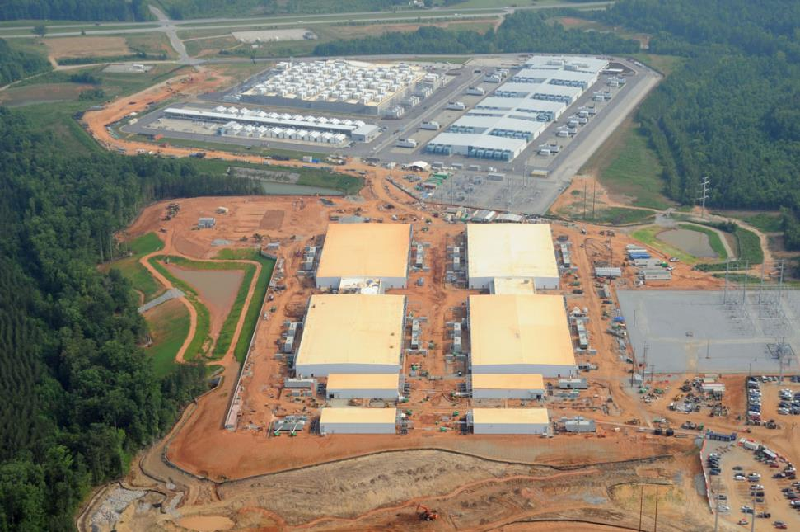
Microsoft Confidential
6

Slide 7
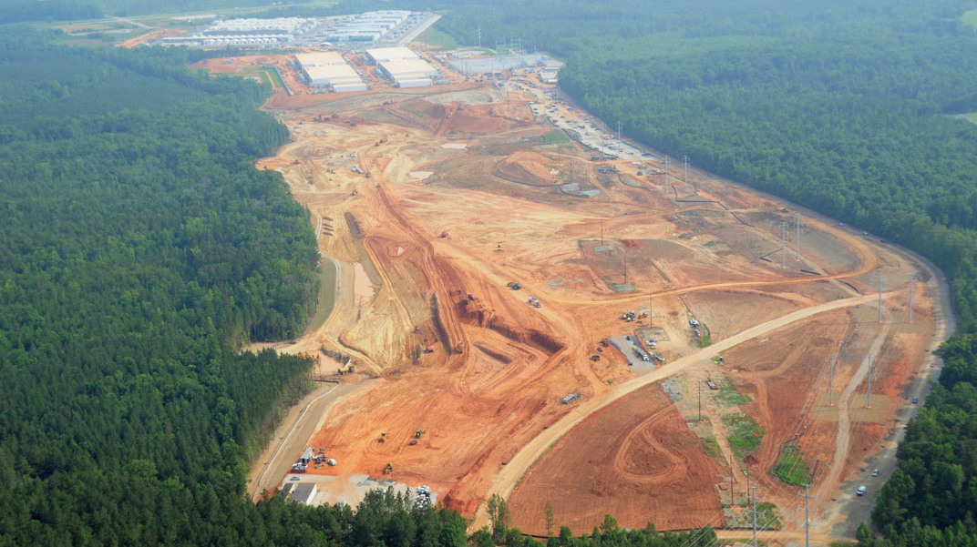

Slide 8
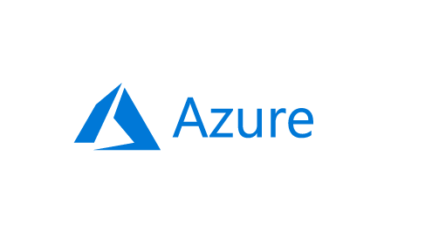

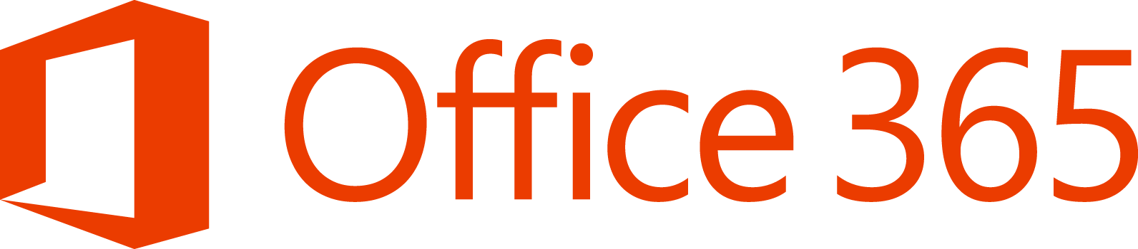

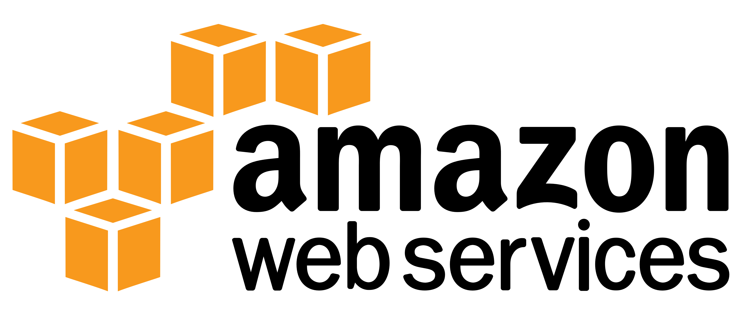

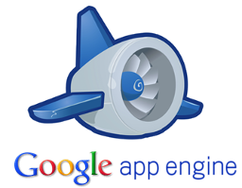

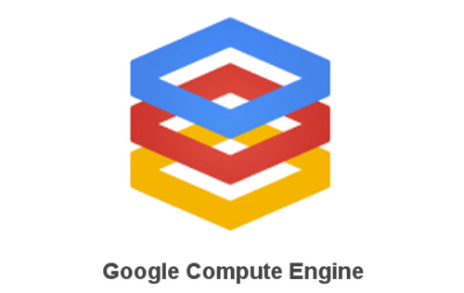
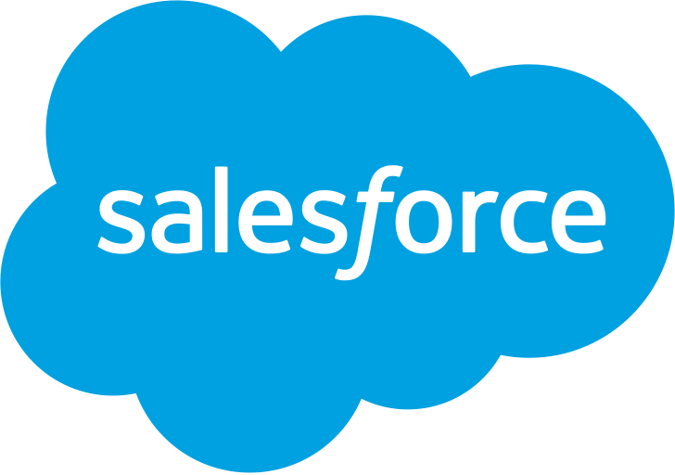
IaaS, PaaS, SaaS?
Traditional
on-premises
Infrastructure
(as a Service)
Platform
(as a Service)
Software
(as a Service)
Applications
Applications
Applications
Applications
You manage
Data
Data
Data
Data
Runtime
You manage
Runtime
Runtime
Runtime
Middleware
Middleware
Middleware
Middleware
You manage
O/S
O/S
O/S
Managed by vendor
O/S
Virtualization
Virtualization
Managed by vendor
Virtualization
Virtualization
Servers
Managed by vendor
Servers
Servers
Servers
Storage
Storage
Storage
Storage
Networking
Networking
Networking
Networking
You manage
Managed by cloud vendor
Notes:
IaaS: New server availability from months to minutes with Azure virtual machines
PaaS: Create new applications and digital services
DBaaS - no need for installing SQL Server,
Same benefits as IaaS, AND
MS takes care of backups, scaling disks, tuning the performance
Just hook in your SQL Management studio and get cracking

Slide 9
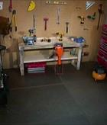
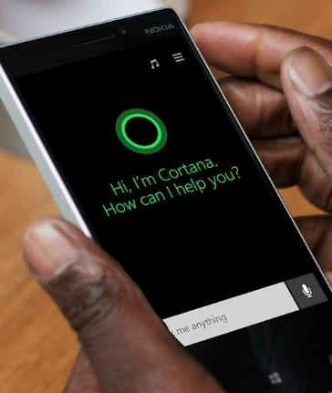
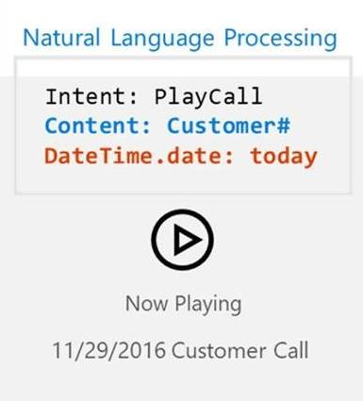
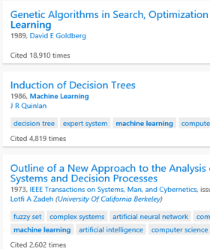
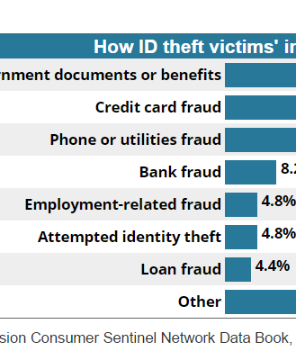
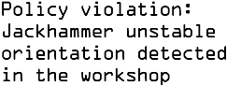
Cognitive Services
Vision
Speech
Language
Knowledge
Search
Computer Vision
Speech-to-text and text-to-speech service
Natural Language Processing
Knowledge Exploration Service
Bing Search
Listening…
Listening…
Listening…
Listening…
Listening…
Object recognition…
Convert this text to speech please…
Play today’s conference call…
Top publications in AI...
Fraud prevention results…

Slide 10
Demo
Cognitive Services

Slide 11
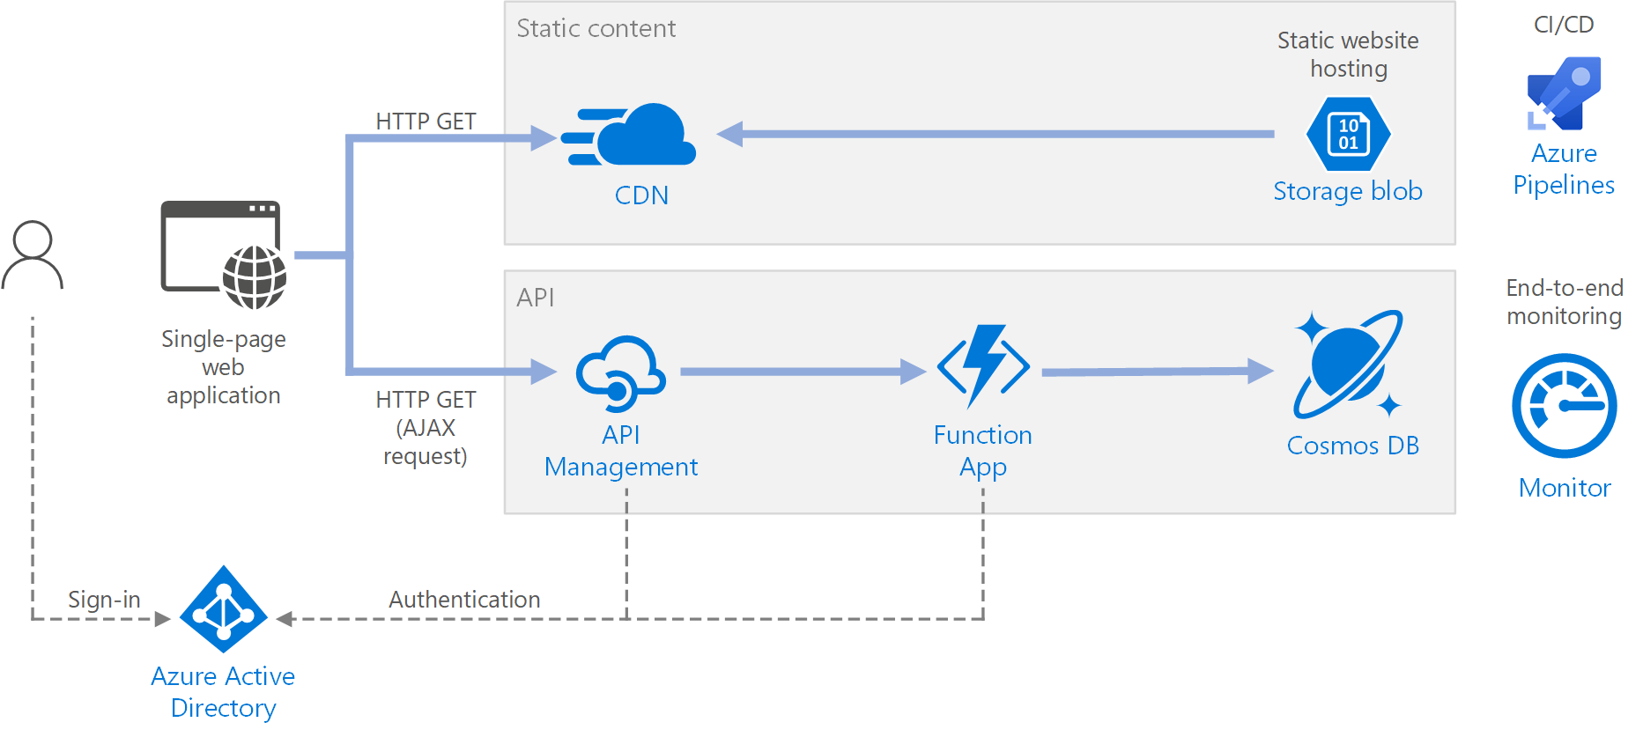

Slide 12
Wrap up

Slide 13
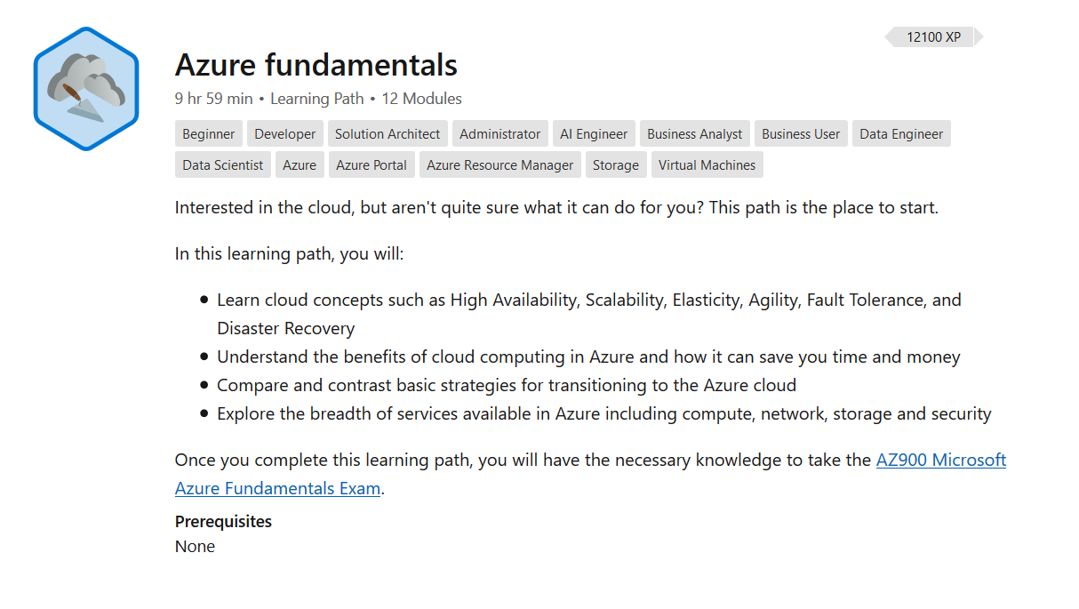

Slide 14
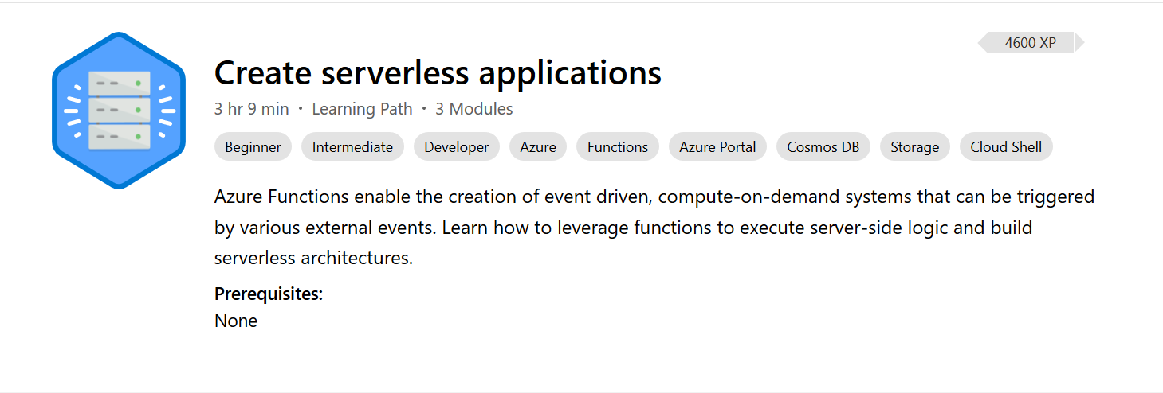

Slide 15
